Slide 1
Statistical Genetics
Lecture 4
Genome-Wide Association Studies (GWAS)

Slide 2
Lecture 4 Readings
Ziegler, A. and Konig I. R. (2010). A Statistical Approach to Genetics Epidemiology: Chapter 14

Slide 3
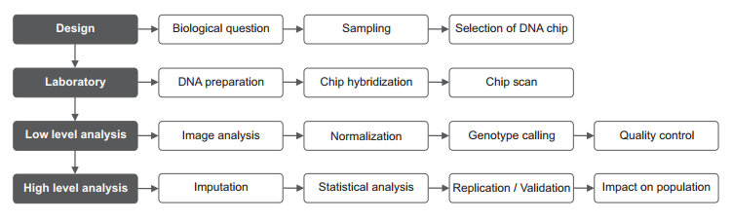
Genome-wide Association Studies
Genome-wide association studies (GWAS) are studies of common genetic variation across the entire human genome designed to identify genetic associations with observable traits.
In GWAS studies, more than 1,000,000 SNPs are possibly genotyped and compared in usually thousands of probands.
The typical workflow of a GWAS is shown below:
Typical workflow of a genome-wide association study.
Notes:
The genetic material that carries the instructions that allow cells to make proteins
Composed of a sugar phosphate backbone from which four nitrogenous bases- adenine (A), guanine (G), cytosine (C), and thymine (T) protrude
Arranged in a double helix- two strands are held together by specific pairings between bases A – T pair and G – C pair

Slide 4
Genome-wide Association Studies
Case-control approaches have become popular partly because population stratification may be estimated from and controlled for using the genetic data
With data from an entire genome scan, we may be able to effectively control for such stratification.
For example, a popular principal component-based technique provides values that may be used as covariates in logistic regression.
A GWAS requires enough markers so that there is a good chance that a causal locus will be highly correlated with at least one marker.
Notes:
The genetic material that carries the instructions that allow cells to make proteins
Composed of a sugar phosphate backbone from which four nitrogenous bases- adenine (A), guanine (G), cytosine (C), and thymine (T) protrude
Arranged in a double helix- two strands are held together by specific pairings between bases A – T pair and G – C pair

Slide 5
Design Considerations
Most of the published studies have used a classical case-control design
Selection of the DNA chip: commercial chips preferred, due to cost-effectiveness and potential for a combination across studies
Examples: HumanHap550 (Illumina) and the Genome-Wide Human SNP Array 6.0 (Affymetrix)
The number of SNPs on a chip or the coverage of the genome it represents, is also important.
Genomic coverage is estimated by the percentage of common SNPs being in high LD, say 𝑟^2≥0.8, with at least one SNP on the platform.
For Caucasian populations, the Human1M (Illumina) has the greatest coverage of 93%, followed by the HumanHap550 (Illumina) and the Genome-Wide Human SNP Array 6.0 (Affymetrix) with 87% and 83%, respectively.
Notes:
The genetic material that carries the instructions that allow cells to make proteins
Composed of a sugar phosphate backbone from which four nitrogenous bases- adenine (A), guanine (G), cytosine (C), and thymine (T) protrude
Arranged in a double helix- two strands are held together by specific pairings between bases A – T pair and G – C pair

Slide 6
Genome-wide Association Studies
Thus, current GWAS use very high-density SNP arrays (500K to 1 million markers).
One basic analysis technique is to obtain SNP-specific test statistics for each SNP, and then control for multiple- testing error.
Unfortunately, the required multiple-comparison penalty is nearly that of the Bonferroni adjustment.
For example, if we have 500,000 markers, then the appropriate significance threshold is nearly 0.05/500,000 = 1X10-7.
“Suggestive” association corresponds to (about) one significant finding per genome scan, or 1/(# markers)
P-value plots for all SNPs provide evidence that population stratification has been controlled
Notes:
The genetic material that carries the instructions that allow cells to make proteins
Composed of a sugar phosphate backbone from which four nitrogenous bases- adenine (A), guanine (G), cytosine (C), and thymine (T) protrude
Arranged in a double helix- two strands are held together by specific pairings between bases A – T pair and G – C pair

Slide 7
Genome-wide Association Studies
Typically regression models are used in GWAS analysis, initially one SNP at a time.
Let g be the genotype at a SNP coded as (say) the number of “minor” alleles at a SNP. This is an arbitrary coding. Also, let x be a covariate (age, sex, or an ancestry-representing covariate).
Case-control analyses usually use the logistic regression model:
This model is fit for each SNP and p-values for the genotype is recorded and examined.
⎛ P(Y = case) ⎞
log
⎜
⎟ = β + β₁g + β₂ x
⎠
⎝
1 − P(Y = case)
0
More or fewer covariates
Notes:
The genetic material that carries the instructions that allow cells to make proteins
Composed of a sugar phosphate backbone from which four nitrogenous bases- adenine (A), guanine (G), cytosine (C), and thymine (T) protrude
Arranged in a double helix- two strands are held together by specific pairings between bases A – T pair and G – C pair

Slide 8
Genome-wide Association Studies
Although the additive model described here is most common, one may also fit the model
which enables the testing of dominant effects.
Quantitative traits are often fit using the linear regression model
Y = β₀ + β₁g + β₂ x + ε
but otherwise interpreted in the same manner.
P(Y = case)
log⎛
⎜ ⎟
1 − P(Y = case)
⎞ = β + β g + β I[g = 2] + β x
⎝ ⎠
0 1 2 3
Notes:
The genetic material that carries the instructions that allow cells to make proteins
Composed of a sugar phosphate backbone from which four nitrogenous bases- adenine (A), guanine (G), cytosine (C), and thymine (T) protrude
Arranged in a double helix- two strands are held together by specific pairings between bases A – T pair and G – C pair

Slide 9
Imputing Missing Genotypes
The imputation of missing genotype data has a number of important applications in GWA studies:
For any SNP, a number of probands will not have valid genotypes after quality control. These could be filled by using the information from the surrounding SNPs and the individuals who were successfully genotyped at the respective SNP.
Although being represented on the platform, a number of SNPs fail the quality control altogether. In this case, these can be imputed.
When comparing results from studies that have used different platforms, one might impute genotypes at SNPs that were not on the respective platform. This is especially useful if a meta-analysis is to be conducted.
The imputation of missing genotypes explicitly or implicitly relies on the accuracy of the haplotype estimates.
If the estimated imputation quality is low, the imputed data should be discarded altogether.
As a measure for imputation quality, the ratio of the empirically observed variance of allele dosage to the theoretically expected variance is used.
Notes:
The genetic material that carries the instructions that allow cells to make proteins
Composed of a sugar phosphate backbone from which four nitrogenous bases- adenine (A), guanine (G), cytosine (C), and thymine (T) protrude
Arranged in a double helix- two strands are held together by specific pairings between bases A – T pair and G – C pair

Slide 10
Correction for Ancestry in GWAS
The presence of population stratification can increase false positives if ancestry is related to disease risk.
Known covariate: Include known/presumed/reported ancestry as a covariate in a regression model.
For example, in a logistic regression model, where case/control status is the response, and genotype for the current SNP is a predictor, along with ancestry covariate.
Genomic control: Looking overall at the set of statistics, we “deflate” them to account for inflation.
For example, the mean of a chi-squared statistic with 1 degree of freedom is 1.0. So we compute
λ = mean(statistics)
and divide each statistic by this single value to obtain corrected
statistics.
Notes:
The genetic material that carries the instructions that allow cells to make proteins
Composed of a sugar phosphate backbone from which four nitrogenous bases- adenine (A), guanine (G), cytosine (C), and thymine (T) protrude
Arranged in a double helix- two strands are held together by specific pairings between bases A – T pair and G – C pair

Slide 11
Correction for Ancestry in GWAS
Bayesian ancestry inference – Tries to find underlying population substructure using many SNPs, then assigns a value or probability to each individual according to proportion of ancestry from each subpopulation. Requires specialized software.
Principal components - takes the matrix of genotypes and recodes them as 0, 1, 2 (e.g. number of minor alleles). Then re-centers and variance standardizes the data and computes principal components. The first few principal components usually correspond to ancestry, and may even take care of some technical artifacts. The PCs are used as covariates in regression.
Nowadays, the principal component approach is preferred.
Notes:
The genetic material that carries the instructions that allow cells to make proteins
Composed of a sugar phosphate backbone from which four nitrogenous bases- adenine (A), guanine (G), cytosine (C), and thymine (T) protrude
Arranged in a double helix- two strands are held together by specific pairings between bases A – T pair and G – C pair

Slide 12
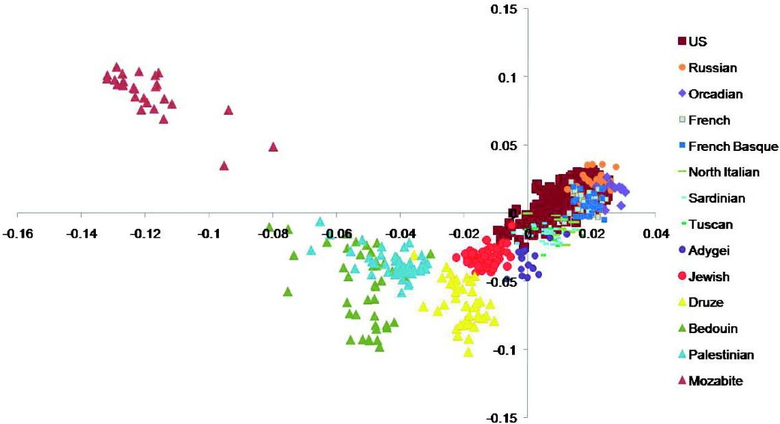
Correction for Ancestry in GWAS
PC2
PC1
Need et al. Genome Biology 2009 10:R7 doi:10.1186/gb-2009-10-1-r7
Notes:
The genetic material that carries the instructions that allow cells to make proteins
Composed of a sugar phosphate backbone from which four nitrogenous bases- adenine (A), guanine (G), cytosine (C), and thymine (T) protrude
Arranged in a double helix- two strands are held together by specific pairings between bases A – T pair and G – C pair

Slide 13
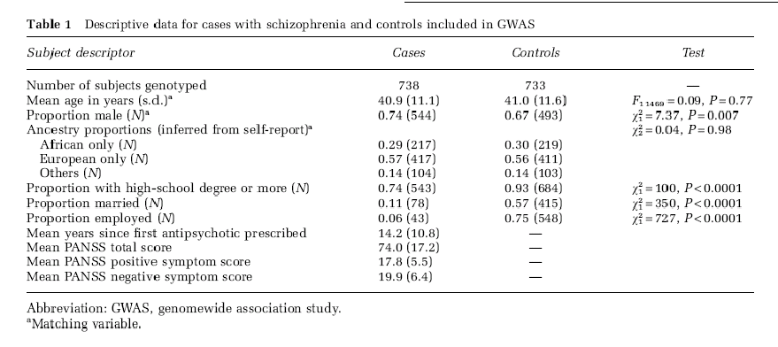
Example: A GWAS for Schizophrenia
Sullivan et al., 2008, Molecular Psychiatry (2008) 13, 570–584
Notes:
The genetic material that carries the instructions that allow cells to make proteins
Composed of a sugar phosphate backbone from which four nitrogenous bases- adenine (A), guanine (G), cytosine (C), and thymine (T) protrude
Arranged in a double helix- two strands are held together by specific pairings between bases A – T pair and G – C pair

Slide 14
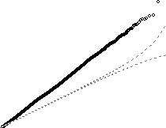
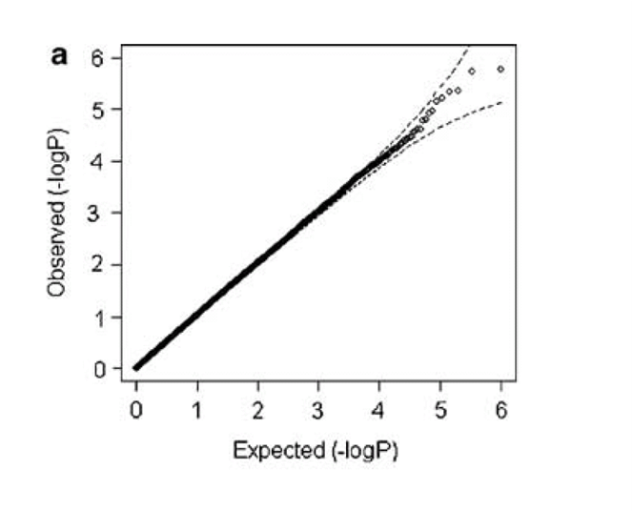
Correction for Ancestry in GWAS
Expected 95% prediction
limits for ordered p-values
P-values before ancestry correction
After ancestry
correction
Notes:
The genetic material that carries the instructions that allow cells to make proteins
Composed of a sugar phosphate backbone from which four nitrogenous bases- adenine (A), guanine (G), cytosine (C), and thymine (T) protrude
Arranged in a double helix- two strands are held together by specific pairings between bases A – T pair and G – C pair

